Slide 1
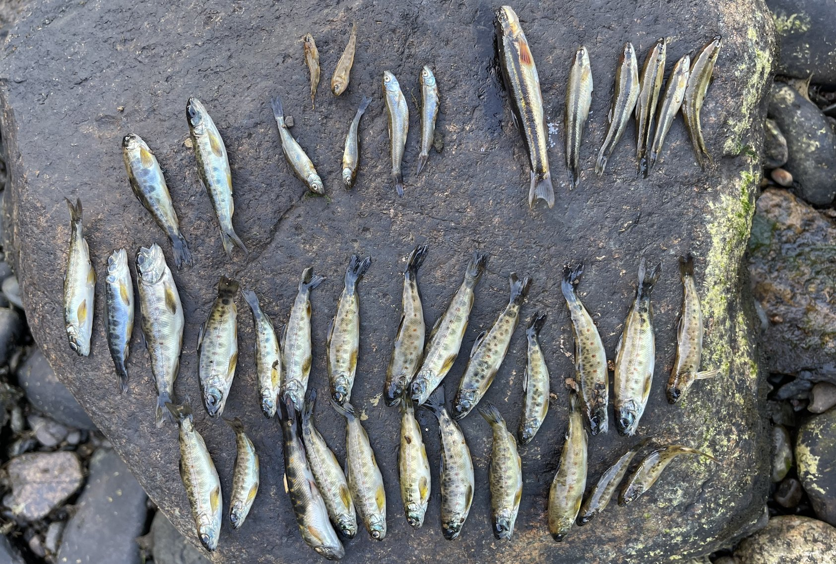


The West Branch of the Penobscot
MAINE COUNCIL
What’s at Stake in Maine’s Largest Hydropower Relicensing
Greater Boston Trout Unlimited • September 28, 2026
Photo: Chris Howe — dead juvenile salmonids and dace, Little A Rapids, July 27, 2026
*
Notes:
Open with the photo: these are juvenile landlocked salmon and sculpins Chris Howe and Noah Duncan picked up along 300 feet of one bank at Little A Rapids the evening of July 27, 2026, after the latest McKay Station trip event. That's the story tonight — Maine's largest hydro relicensing, and why it matters to anglers in Massachusetts.

Slide 2
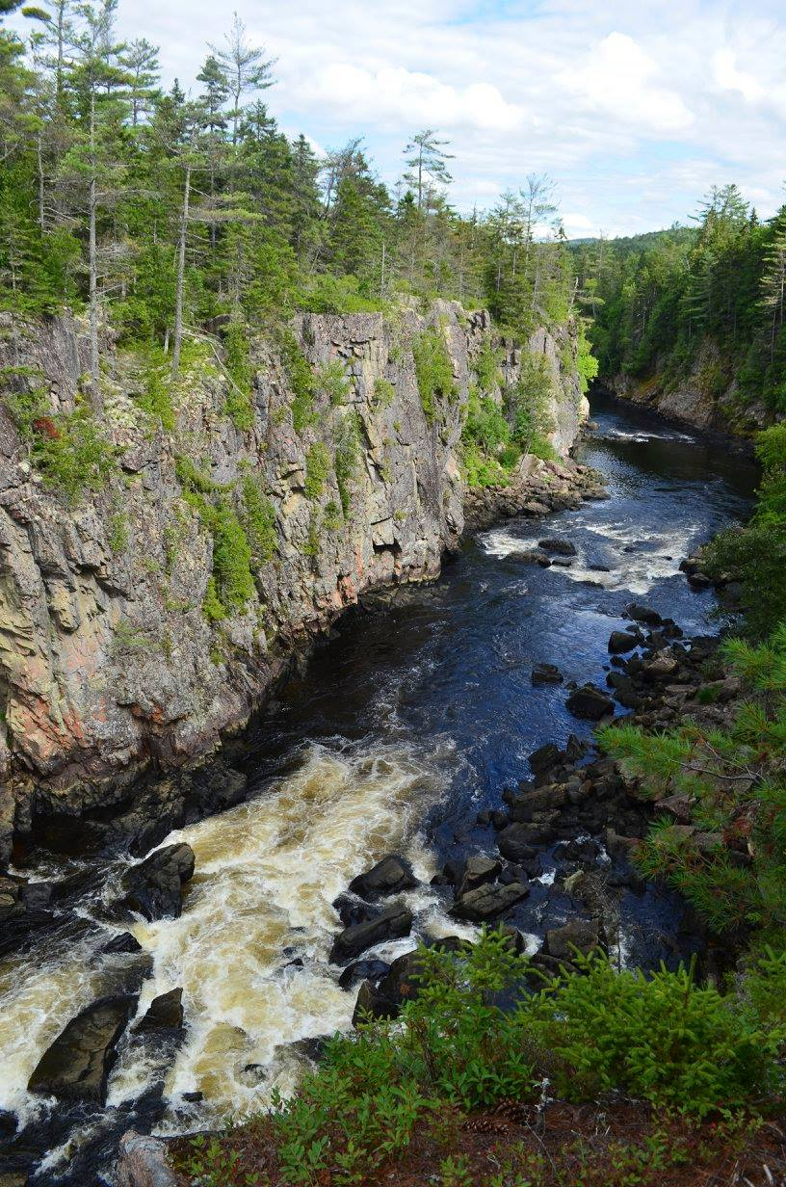
Why the West Branch Matters
One of the most important coldwater rivers in New England
Destination fishery — still outstanding, but declining
Iconic gorge, premier whitewater, and Maine’s third‑largest lake system
Largest hydropower relicensing in Maine
  Licenses expire September 30, 2026
  New licenses will govern hydro ops for the next three to five decades
Photo: Sarah Sindo
Notes:
The West Branch is one of New England's premier coldwater rivers. The current licenses expire September 30 — two days from now. Whatever FERC issues next will govern this river for the next 40 years.

Slide 3
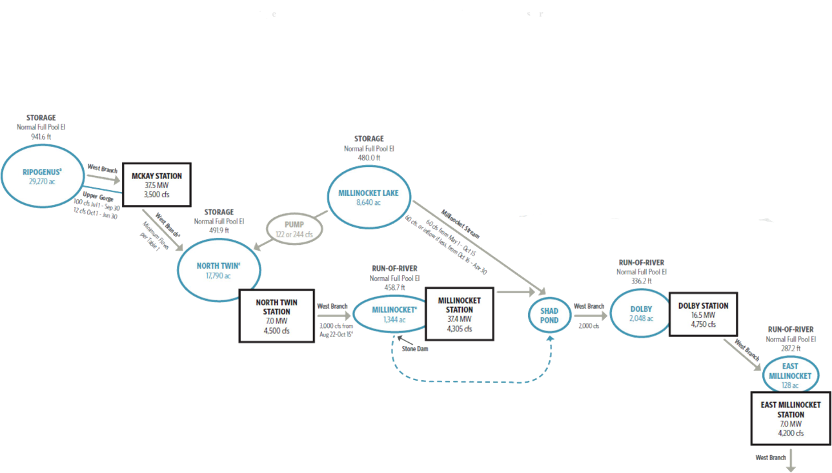
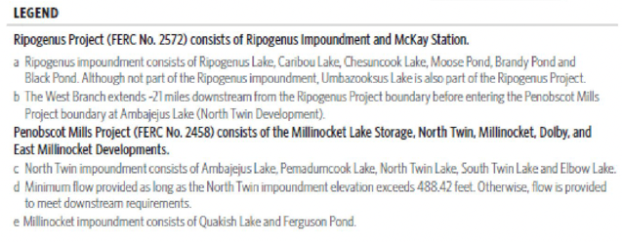
Two Projects Relicensed Together
Ripogenus Project
  Rip Dam
  McKay Station
      Ripogenus-Chesuncook-Caribou Impoundment
Penobscot Mills Project
  North Twin
  Millinocket Lake
  Dolby
  East Millinocket
      Numerous impoundments and lakes involved – other complexities
Notes:
Backup: the two projects and their developments.

Slide 4
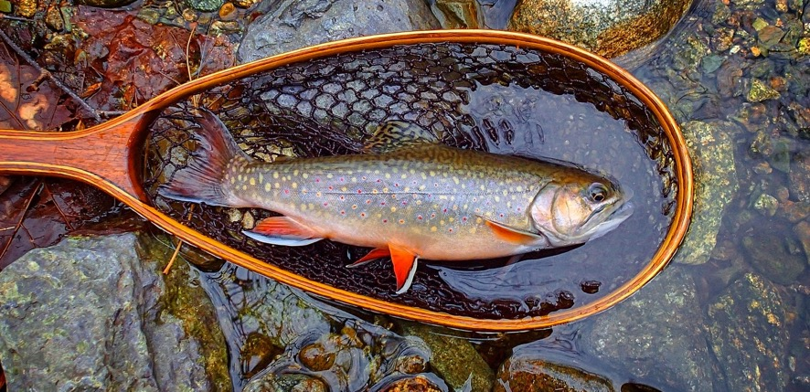
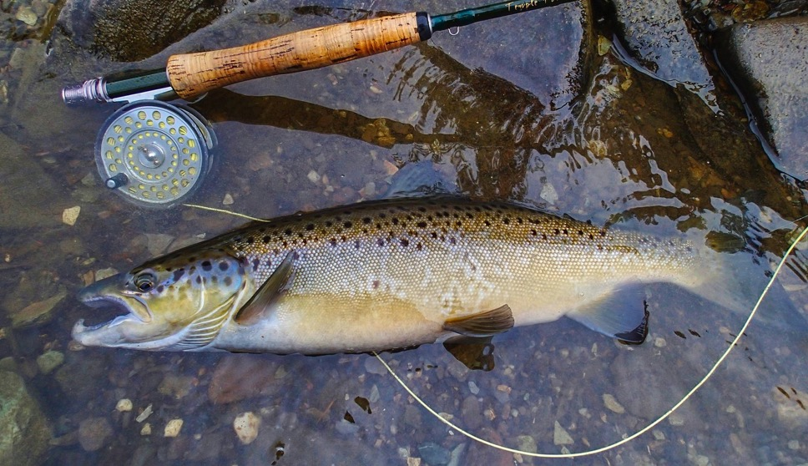
The Fish Tell the Story
Functionally a catch and release fishery with miles of FFO or Artificials only
Best landlocked salmon fishery in New England (wild brook trout too)
  Wild fish – NO stocking on the West Branch
Size quality and abundance declining
  trends tied to operations, not biology
License terms will determine recovery or continued erosion
Photos: Tim Shaw
Notes:
Wild fish, no stocking, mostly fly-fishing-only water. These are the fish the license terms decide the future of. The size and abundance trends are tied to how the river is operated, not to biology.

Slide 5
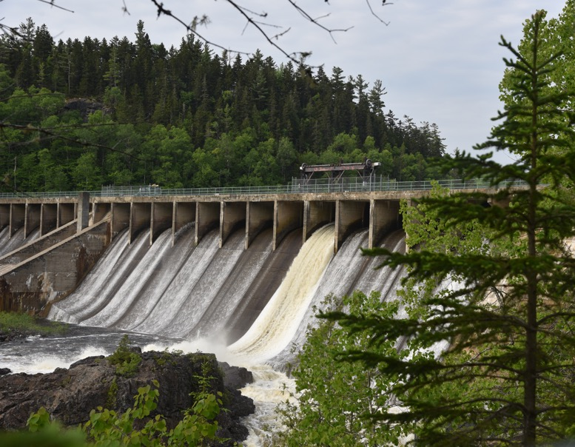
Project Scale
Ripogenus and Penobscot Mills projects are the largest generation effort in the state
Projects being relicensed together
Very Complex – 5 powerhouses
Owned by Brookfield
  Cash cow if one exists
Photo: Chris Howe
Notes:
Two projects, five powerhouses, relicensed together — the largest hydro generation complex in Maine, owned by Brookfield.

Slide 6
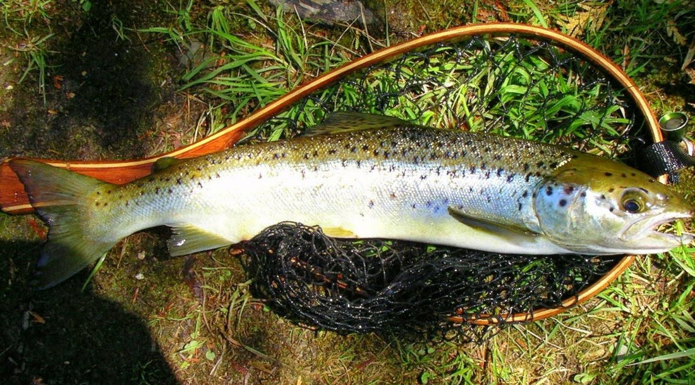
Ownership and Control
Brookfield Renewable
83% of Maine hydro capacity
Centralized operations, fewer local staff
Profits flow primarily to Canada and shareholders
Deerfield project’s owner
Photo: Tim Shaw
Notes:
Brookfield owns about 83% of Maine's hydro capacity. Operations are centralized, local staffing has shrunk, and it is the same company that owns the Deerfield projects many of you know.

Slide 7
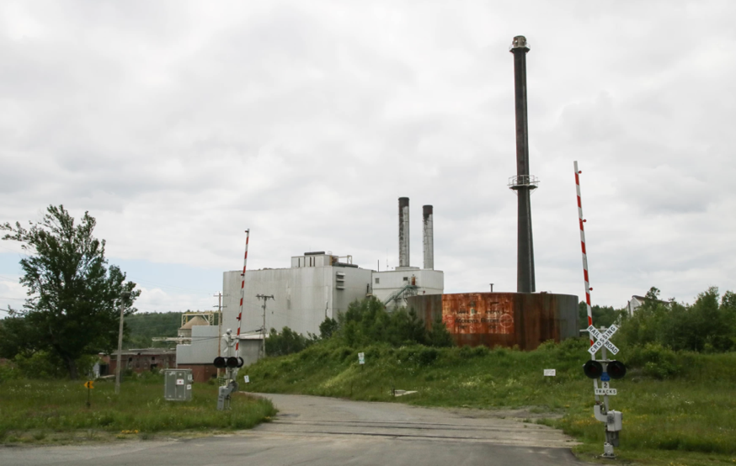
The Last License Still Runs the River
Issued ~30 years ago to Great Northern Paper
  GNP then Maine’s largest employer
Environmental protections weakened under political pressure
License optimized to increase asset value prior to sale
Last license was not what the resource needed
Those terms still govern operations today
Next license term:
  30 to 50 years
Notes:
The 1996 license was written for Great Northern Paper when it was Maine's largest employer. Environmental protections were weakened under that pressure — and those terms still run the river today.

Slide 8
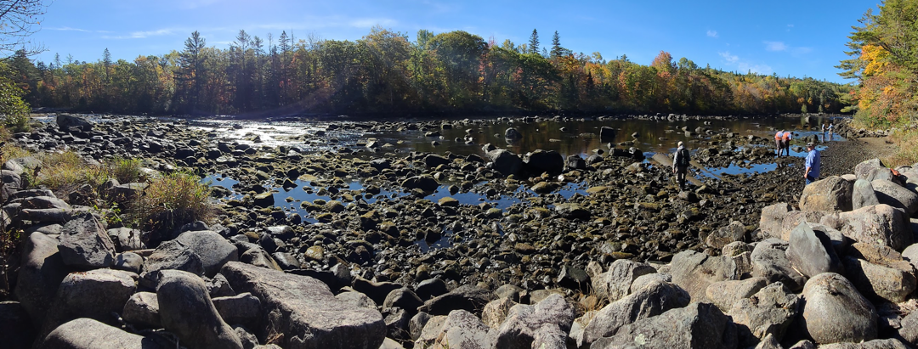
What’s Going Wrong
Structural license flaws allow harmful operations
Generator trip events average ~1 per year — fish kills in 2023, 2025, 2026
YOY landlocked salmon most vulnerable (state fish)
‘Acts of nature’ = no FERC violations [yet], no consequences
Notes:
The license treats outages as acts of nature — no violation, no consequence. Three trip events in four years have killed fish: July 2023, June 2025, and July 27 of this year.

Slide 9
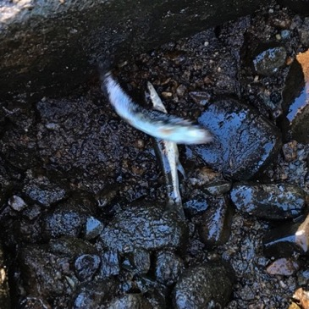
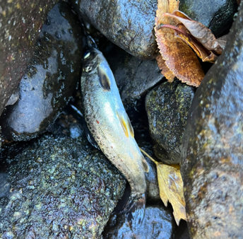
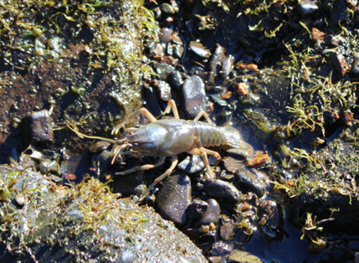
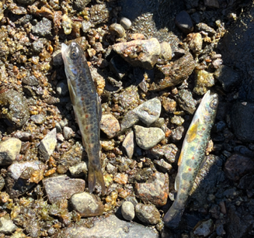
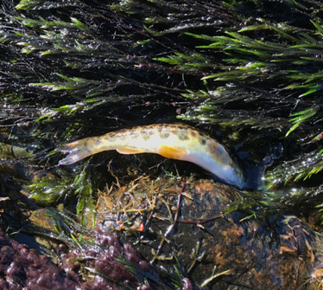
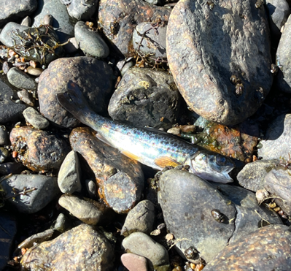
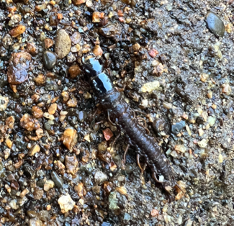
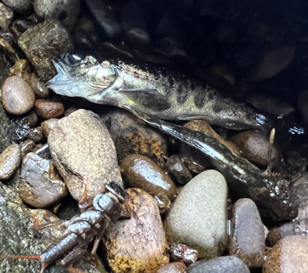
Documented Impacts
Stranding and mortality documented by Brookfield and TU volunteers
Fish, eggs, and macroinvertebrates affected
Short‑duration events, high biological consequence
Notes:
These photos come from Brookfield's 2022 stranding study and TU volunteer surveys. The events are short, but the biological consequences are large — fish, eggs and the insects they feed on.

Slide 10
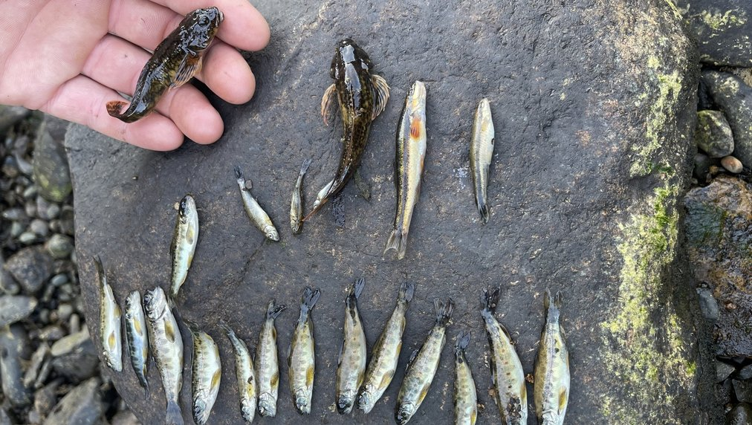
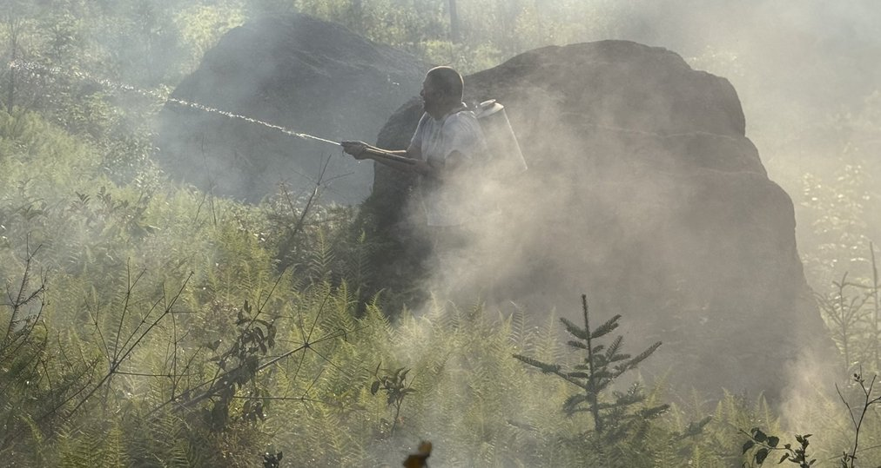
July 27, 2026: Another Trip Event
Broken cross-arm on the McKay Station transmission line tripped the station offline
Flows fell from ~2,400 cfs to ~450 cfs for two-plus hours
TU’s preliminary estimate: 3,860 landlocked salmon parr killed — up to ~7,700
  Plus brook trout parr, dace, suckers and sculpins
Brookfield did no field survey
Downed line started a forest fire — the second in 13 months
Third fish-kill trip event in four years
Maine TU Council responded to Brookfield’s Flow Excursion Report
Photos: Chris Howe (top), Todd Mercer(bottom)
Notes:
On July 27 a cross-arm broke on the McKay Station transmission line — the second cross-arm failure in 13 months. Flows dropped from about 2,400 to about 450 cfs for more than two hours. Chris Howe and Noah Duncan collected the dead fish at Little A Rapids that evening. Scaling up the fish found on 300 feet of one bank gives TU's preliminary estimate of 3,860 landlocked salmon parr, and up to about 7,700 if the stranded fish they released are counted. Brookfield did no field survey. The line also started a fire, which guide Todd Mercer and others fought with backpack pumps until the Maine Forest Service arrived.

Slide 11
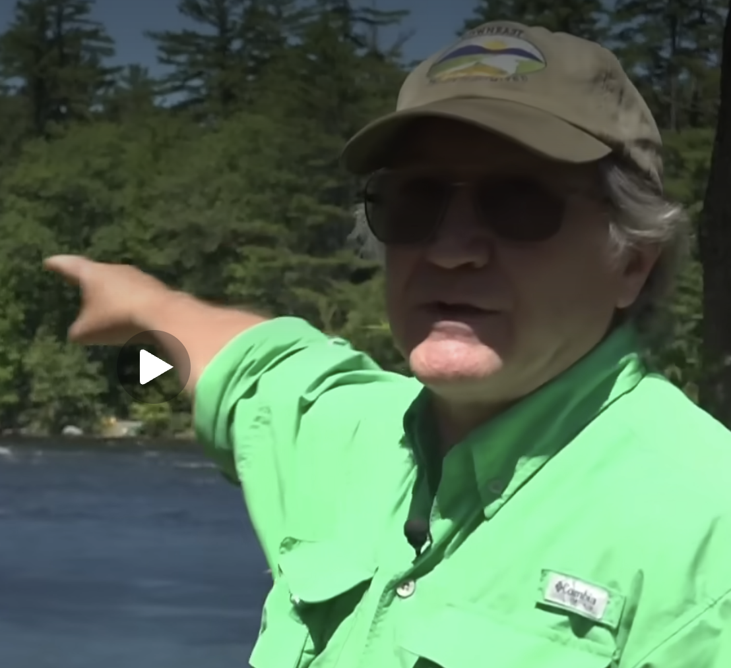
Media Coverage
Press releases have resulted in coverage of the latest trip event and relicensing in Bangor print and TV media for the Ripogenus/Penobscot Mills Projects. URLs include:
Bangor Daily News, July 30, 2026
https://www.bangordailynews.com/2026/07/30/outdoors/outdoors-environment/thousands-of-fish-may-have-died-in-penobscot-river-dam-shutdown/
Bangor Daily News (Maine Focus), Aug. 17, 2026
https://www.bangordailynews.com/2026/08/17/mainefocus/mainefocus-environment/ripogenus-dam-shutdown-impacts-joam40zk0w/
WABI TV5, July 31, 2026
https://www.wabi.tv/2026/07/31/maine-dep-investigating-fish-kill-west-branch-penobscot-river/
NEWS CENTER Maine (WCSH), Sept. 2, 2026
https://www.newscentermaine.com/article/news/local/public-safety/power-line-failure-drains-west-branch-penobscot-river-kill-thousands-fish-maine/97-e9e4edd5-c977-4f1b-8a96-22b01224bdff
Notes:
Backup: media coverage. Press releases produced coverage of the July 27 trip event and the relicensing in Bangor print and TV media. The BDN ran the July 30 story and an August 17 Maine Focus piece; WABI covered the DEP investigation on July 31.

Slide 12
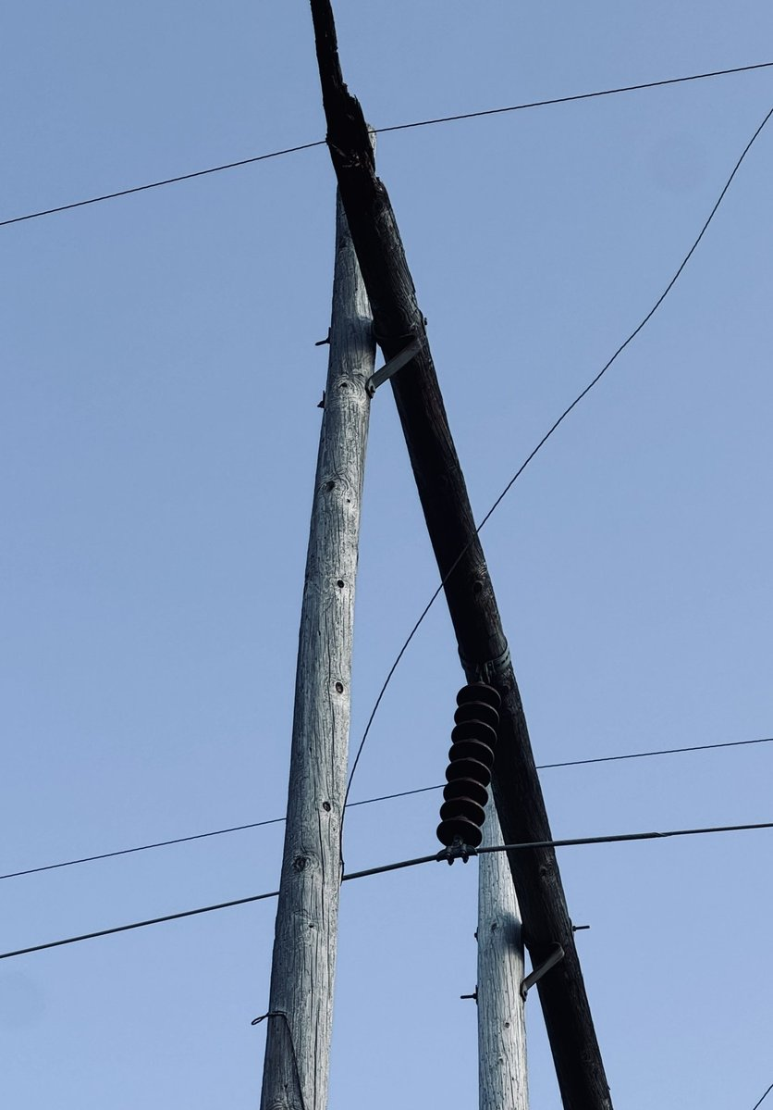
FERC Responds
August 27: Additional Information Request — 60 days to answer (about October 26)
  Cited TU comments extensively
Brookfield must:
  Report the number of fish killed — and say whether it agrees with TU’s estimate
  Itemize all transmission-line work since 2016, answering TU’s challenge to its “$3 million” claim
  Hand over the raw flow data behind its outage graph
  Respond to TU’s request for a USGS gage at Telos Bridge
  Explain how flows fell below the 400 cfs outage minimum
  Propose how it will stop these fish kills until a new license issues
Photo: Todd Mercer - the failed pole span, July 2026
Notes:
FERC's compliance staff answered on August 27 with an Additional Information Request that cites TU's comments by name repeatedly. Brookfield has 60 days. The most important item is the last one: FERC found that the Article 402 outage flow does not protect fish, and told Brookfield to propose how it will address these fish kills until a new license issues.

Slide 13
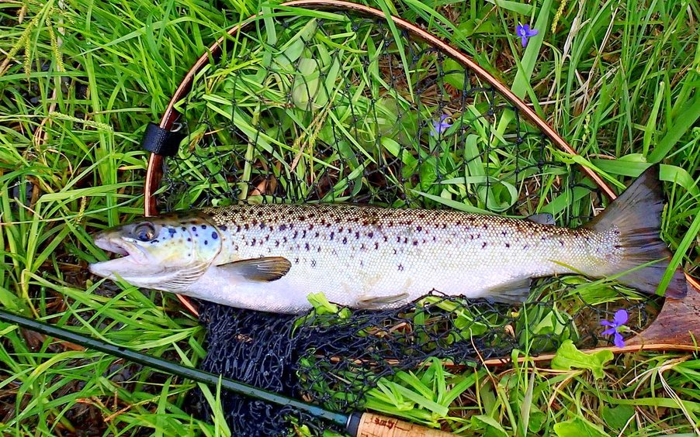
Maine DEP Weighs In
August 28: McKay Station outages “violate State Water Quality Standards”
Interim measures while relicensing is pending:
  Restore minimum flow within 24 hours (now 72)
  USGS gage at Telos Bridge
  Faster line maintenance
Permanent fix in the new license: bypass valve, permanent dam keeper, or MDIFW’s alternative
MDEP now holds Brookfield’s Water Quality Certification applications
  Coalition files WQC Application Comments in early December
Photo: Tim Shaw
Notes:
Maine DEP, which decides the state Water Quality Certification, found that these outages violate state water quality standards. It asked FERC for interim measures now and a permanent fix in the new license — including two of TU's long-standing asks, the Telos Bridge gauge and a dam keeper. Brookfield filed its certification applications on August 27; MDEP has until August 27, 2027 to act.

Slide 14
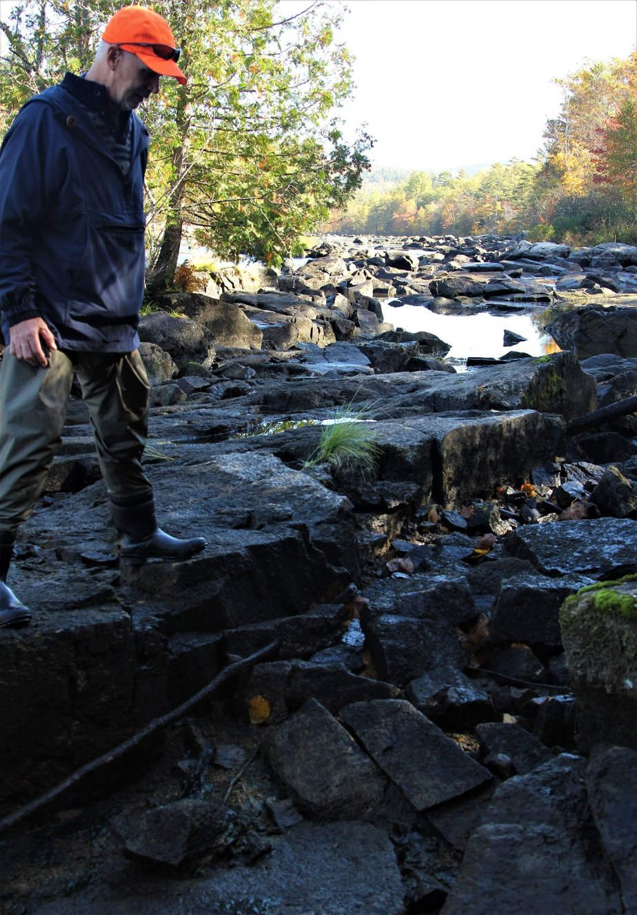
TU Volunteer Effort
Stranding Study: field surveys, photos, GPS, timing
Ramping Study: flow change impacts
Fishability/Wadability assessments
Organized evidence, not anecdote
Notes:
TU volunteers did field work for the stranding study, the ramping study and fishability/wadability assessments — organized evidence, not anecdote.

Slide 15
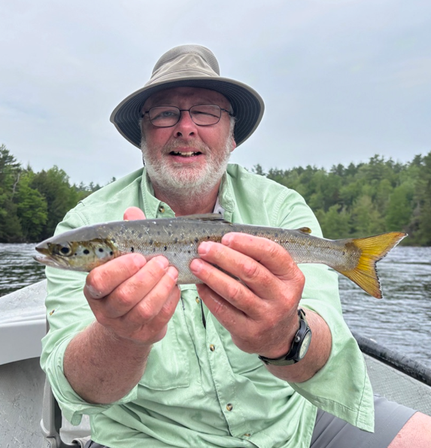
Angler Use & Economic Value Survey
Conducted by retired fisheries biologist Neal Hagstrom
Four‑month professional angler use survey summer 2025
Completed without compensation
Filled critical data gaps Brookfield did not address
Adverse conditions affecting the fishery
  Higher and more variable water temperatures
  Decreased size and quality of landlocked salmon and wild trout
  Flow instability that disrupts feeding, holding water, and angler access
Photo: Chuck Waganheim
Notes:
Neal Hagstrom ran a four-month professional angler survey in summer 2025, without pay, filling data gaps Brookfield never addressed. The survey documented warmer and more variable water, smaller fish, and flow instability that disrupts feeding and access.

Slide 16
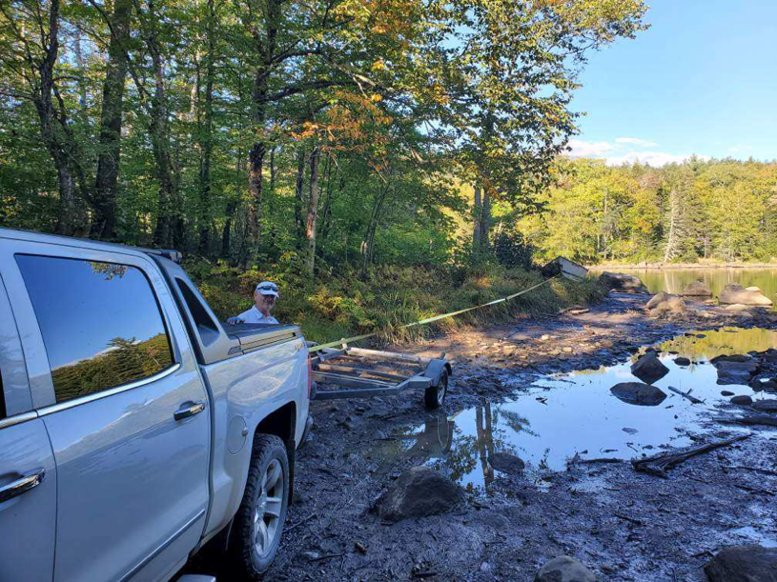
Impacts on guided fishing and trip quality
Guides report shortened or canceled trips during warm water or low-flow periods
Increased need to shift timing or locations, reducing trip quality and success
Repeat clients notice changes in fish size and consistency, affecting return visits
Notes:
Guides report shortened and canceled trips, and repeat clients notice the fish getting smaller.

Slide 17
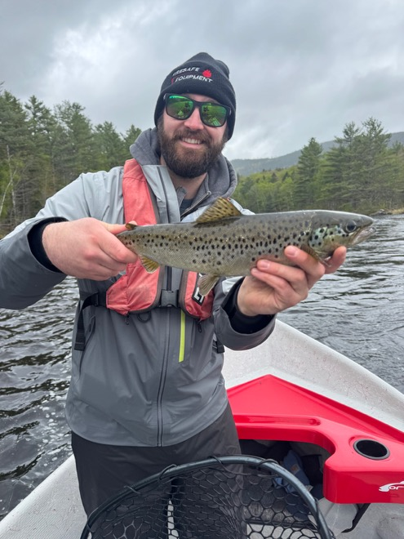
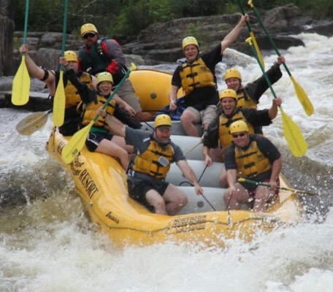
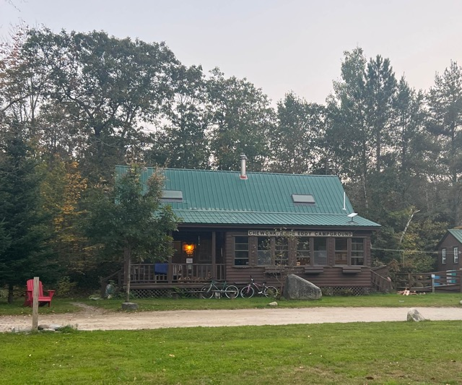
The West Branch Affects the Regional Economy
Notes:
The West Branch economy is guides, sporting camps, rafting and lodging — it depends on the river.

Slide 18

Economic Value of the West Branch Fishery
Economic significance
  Angler spending supports:
  Guides and sporting camps
  Lodging, food, fuel, and retail in surrounding communities
Total economic impact
  2025 value estimated at $1.87 million,
  Projected 50-year cumulative impact $163,575,899
Why this matters for relicensing
  The fishery has real, measurable economic value that depends on stable flows
  Declines in fish size, abundance, or access translate directly into lost economic activity
Notes:
The survey put the 2025 value at about $1.87 million, with a projected 50-year cumulative impact of about $164 million.

Slide 19
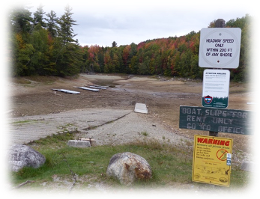
TU led - the Coalition Grew
2025: four user groups — anglers, camp owners, whitewater, hikers
August 25, 2026 filing: 17 signers representing 19 organizations
  Conservation and angling: Maine TU, American Rivers, American Whitewater, Appalachian Mountain Club, Atlantic Salmon Federation, Maine Rivers, Penobscot Bay Waterkeeper, Fin & Feather Club
  Lake associations and landowners: three Chesuncook/Caribou associations, Andre Emerson Cushing Corporation
  Guides and outdoor businesses: guide services, outfitters and a campground
Together we are stronger
Notes:
Last year I described four user groups working together. On August 25 the coalition filed with 17 signers representing 19 organizations — anglers, lake camp owners, whitewater and hiking groups, river conservation groups, and the guides whose livelihoods depend on the river.

Slide 20
The Coalition Signers
Conservation & Angling
Maine Council of Trout Unlimited
American Rivers
American Whitewater
Appalachian Mountain Club
Atlantic Salmon Federation
Maine Rivers
Penobscot Bay Waterkeeper
Fin & Feather Club of Maine
Lake Associations & Landowners
Caribou and Chesuncook Lake Lot Owners Association
Chesuncook Dam Camp Owners Association
Chesuncook Village Association
Andre Emerson Cushing Corporation
Guides & Outdoor Businesses
Maine Guide Fly Shop & Guide Service
T&J’s Maineiac Outfitter
Maine Fishing Adventures
Horizon Line Adventures
Northern Rivers Fly Fishing
Maine Quest Adventures
Allagash Gateway Campground
Joint comments on the Final License Application, filed August 25, 2026 (FERC Accession 20260825-5157). NRCM filed separately in support.
Notes:
Here is everyone who signed: 17 signature blocks representing 19 organizations — national groups like American Rivers, American Whitewater, AMC and the Atlantic Salmon Federation; the Chesuncook and Caribou lake associations and the largest landowner on Ripogenus Lake; and seven guide services and outdoor businesses. NRCM filed separate comments supporting ours.

Slide 21
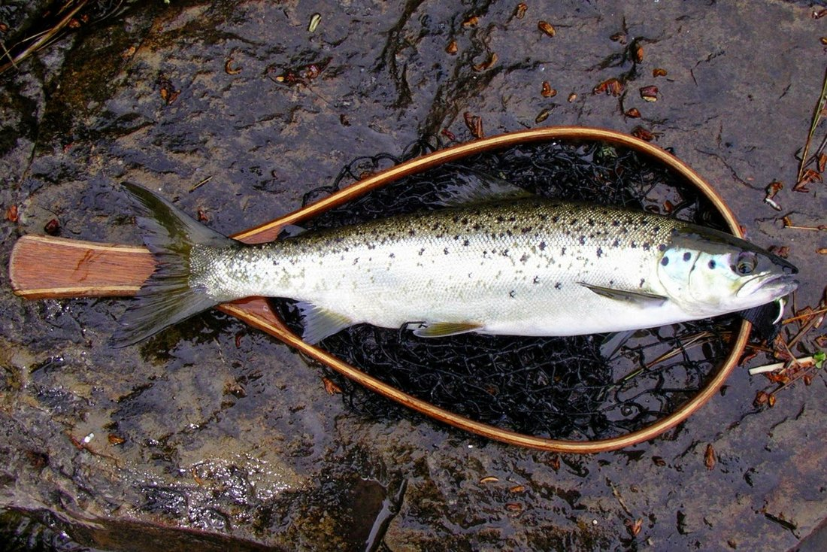
What the Coalition Told FERC
Filed August 25, 2026 in both dockets
Two fundamental flaws in Brookfield’s application:
  Ignores the changes since the paper mills closed
  Ignores how the projects really run — as peaking merchant generators
Brookfield withheld data, resisted study designs, left consultation requests unanswered
Three fish-kill trip events in four years
State and federal agencies documented many of the same concerns
Photo: Tim Shaw
Notes:
The coalition filed one combined set of comments in both dockets on August 25. The core argument: Brookfield's application treats these as the storage projects they were when the mills ran, not the peaking merchant generators they are today — and the record Brookfield built is too thin to support new 40-year licenses.

Slide 22
What the Coalition Asked For
Upper Gorge: 200–400 cfs cold water, year-round (Brookfield proposes 100 seaspnal)
Below Stone Dam: 500–700 cfs (Brookfield proposes 200)
Lakes: within 1.5 ft of full pool to June 15; no more than 4.9 ft down by September 15
Ramping: no more than 1 inch/hour stage change (or 25%/hour flow change)
Outages: instant protection — automated release, bypass valve, or dam keeper
USGS gage at Telos Bridge now, at Brookfield’s expense
A full Environmental Impact Statement covering both projects
An independent biological studies fund, as MDIFW has proposed
Notes:
These are the specific conditions the coalition asked FERC to write into the licenses. Where FERC thinks the record is too thin for a final number, we asked for the studies plus an adaptive-management framework and interim protections — not another 30 years of open-ended study obligations.

Slide 23
Supporting Comments by State
87
individual comments supporting coalition positions, August 2026
64
from Maine residents
Individual comments filed on FERC docket P-2572 in August 2026 supporting coalition/CCLA positions; duplicate filings removed; 2 scanned letters without a state not counted.
Notes:
Public support: 87 people filed individual comments in August backing the coalition's positions. Most are from Maine — but Massachusetts is number one outside Maine, from Milton, Berkley, Waltham, Framingham, Dighton and Franklin. Your comments count.

Slide 24
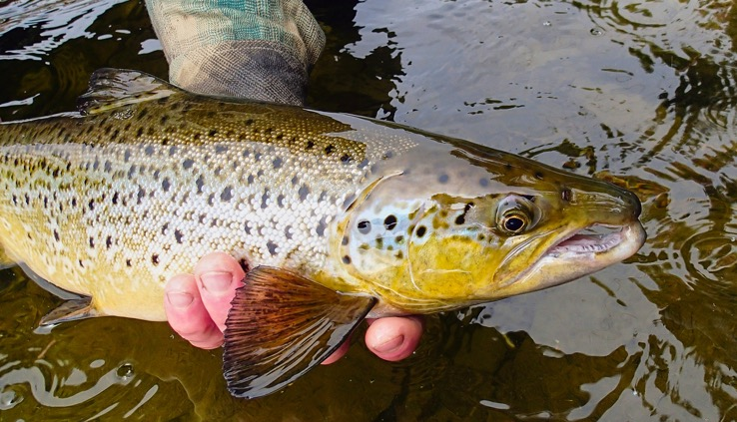
Asks for New FERC License
Enforceable operating conditions
  Lake Levels (Rip–Chesuncook–Caribou)
  Flow Stability: Enforceable Flow Restrictions
  Water the Upper Gorge Year-Round
  Prevent Stranding: Operational Safeguards
  The Reach Below Stone Dam (Mainstem Matters)
  Fish Passage and Connectivity
Photo: Tim Shaw
Notes:
These are the enforceable operating conditions the coalition is asking FERC to write into the new licenses.

Slide 25
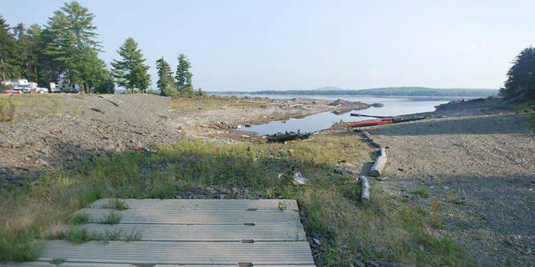
Stabilize Lake Levels (Rip–Chesuncook–Caribou)
Hold within 1.5 ft of full pool through June 15
Summer drawdown no more than 4.9 ft by September 15
  Maintain access to boat ramps
Winter drawdown limit (16.5 ft maximum)
Littoral zone protection (loons, habitat)
Recreation + fishery support
Notes:
These are the lake-level numbers in the coalition's proposed Water Use Plan, developed with the Caribou and Chesuncook lake associations: stay within a foot and a half of full through mid-June for smelt spawning and loons, then no more than 4.9 feet down by mid-September.

Slide 26
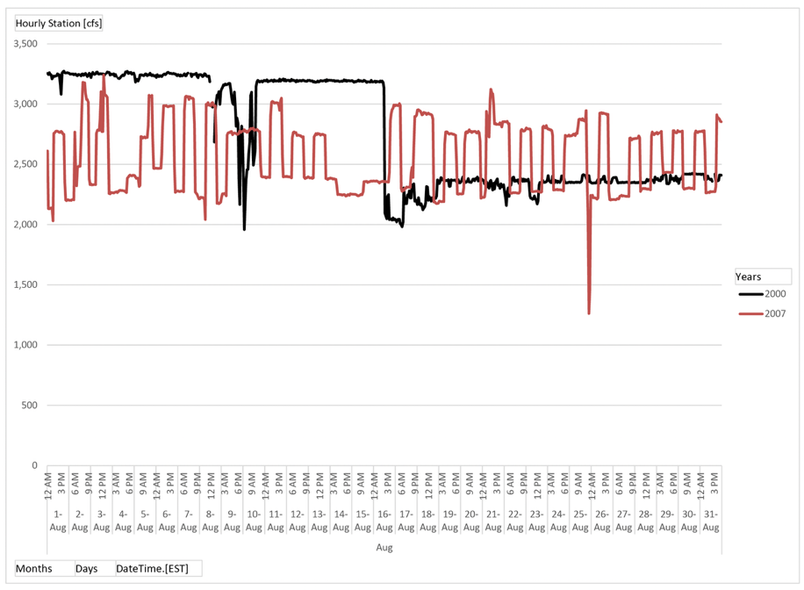
Peaking’s Subtler Effects
“… hydropeaking operations do have negative effects on fish populations, particularly smaller bodied species or life stages, the ultimate effect on fish populations is determined by degree of hydropeaking…” Source: The ups and downs of hydropeaking: a Canadian perspective on the need for, and ecological costs of, peaking hydropower production, K. E. Smokorowski; Hydrobiologia (2022) 849:421–441, page 431.
Notes:
Backup: the peaking literature — hydropeaking harms smaller fish and early life stages.

Slide 27
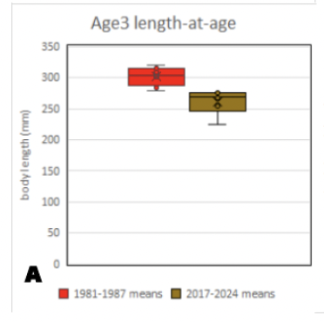
Flow Stability: Enforceable Flow Restrictions
Ramping rates
  Stop abrupt flow changes
  Step down flows gradually when changed
  No more than 1 inch/hour stage change (or 25%/hour flow change)
Terms must be binding and enforceable on Ripogenus operations
Affects both the fish and the fishing
Notes:
Ramping: the coalition asked for a hard limit — no more than one inch per hour of stage change, or alternatively 25 percent per hour of flow change, whichever the data show is more protective. MDIFW has recommended the same 25 percent figure.

Slide 28
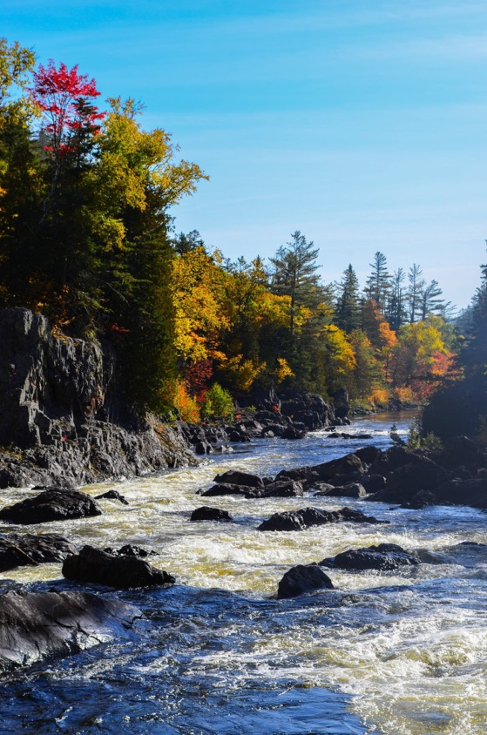
Water the Upper Gorge Year-Round
200–400 cfs year-round through the Upper Gorge
  Cold water from the deep gates, not sluice-gate leakage
  Cooler waters
  Sluice gate flows in gorge 77 degrees August 2025
Habitat + aesthetics + recreation
Align with compliance needs and real-world use
Photo: Sarah Sindo
Notes:
The coalition asks for a year-round 200 to 400 cfs cold-water flow through the Upper Gorge, drawn from the deep gates. Sluice-gate water in the gorge hit 77 degrees in August 2025.

Slide 29
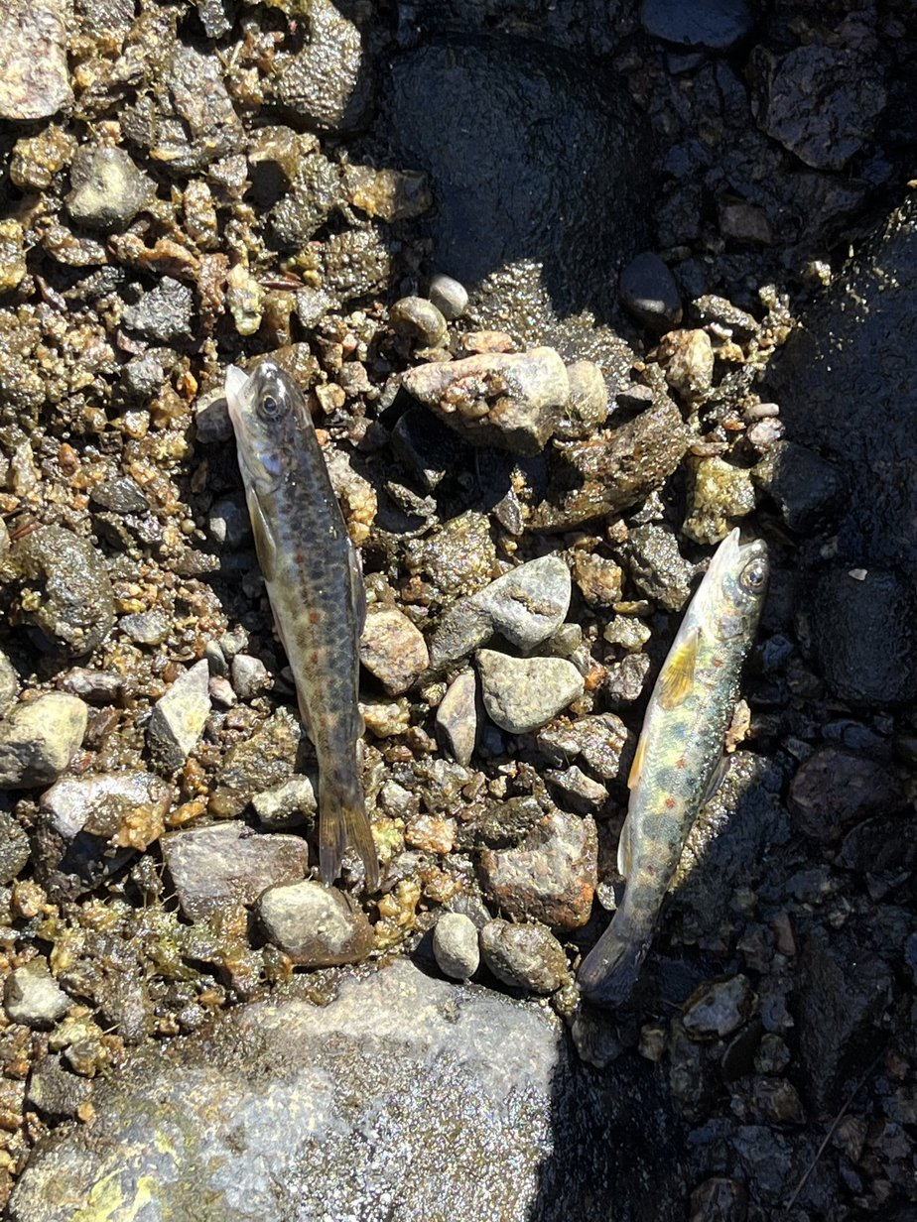
Prevent Stranding: Operational Safeguards
Instant outage flow: automated deep-gate release or bypass valve
Ramping rates to reduce stranding risk
Restore dam keeper / local staffing to reduce restoration time and improve safety
USGS flow gage at Telos Bridge — now, at Brookfield’s expense
Photo: two dead salmon parr, TU stranding survey, October 2022
Notes:
The fix for stranding is not complicated: an instant outage flow so the river never drops to leakage, ramping limits, someone on site who can open a gate, and an independent gage so we have real data. These two parr were found on dry cobble during the October 2022 stranding study.

Slide 30
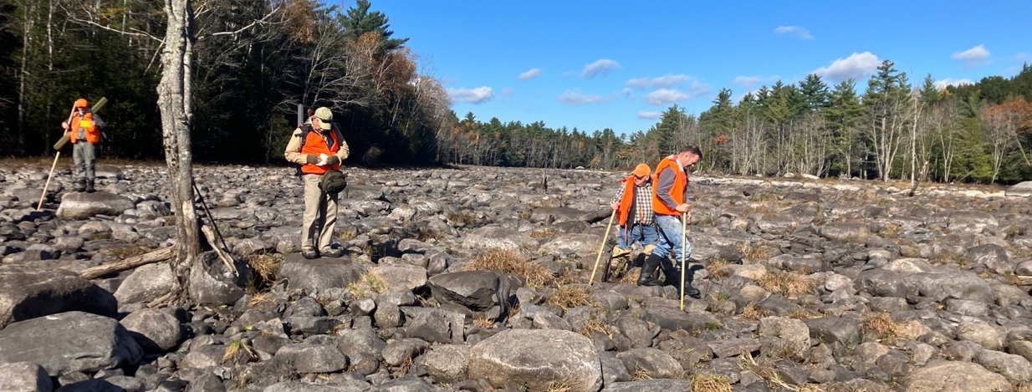
The Reach Below Stone Dam (Mainstem Matters)
Penobscot Mills, “Other” part of relicensing – Millinocket vicinity
Current operations/flows leave reaches too low to function as adult fish habitat
Brookfield proposal inconsistent with:
  their own study indications (e.g., higher flows better for adult fish habitat)
  what was proposed/expected in last relicensing context
Coalition asks 500–700 cfs year-round (Brookfield proposes 200 cfs)
Notes:
Below Stone Dam, Brookfield proposes 200 cfs — enough to wade across bank to bank. The coalition asks for 500 to 700 cfs, a level that supports adult brook trout and good insect production.

Slide 31

Fish Passage and Connectivity
Lesser concern for West Branch
No fish passage at first dam on West Branch – Medway Dam
Eel and other diadromous species longer term concern for Penobscot Mills project
Eel Passage concern for Ripogenus Project
  ~12-inch eel documented below McKay Station during Ramping Study
Notes:
Fish passage is a lesser concern on the West Branch itself, but eels are documented below McKay Station and passage matters for the Penobscot Mills project.

Slide 32
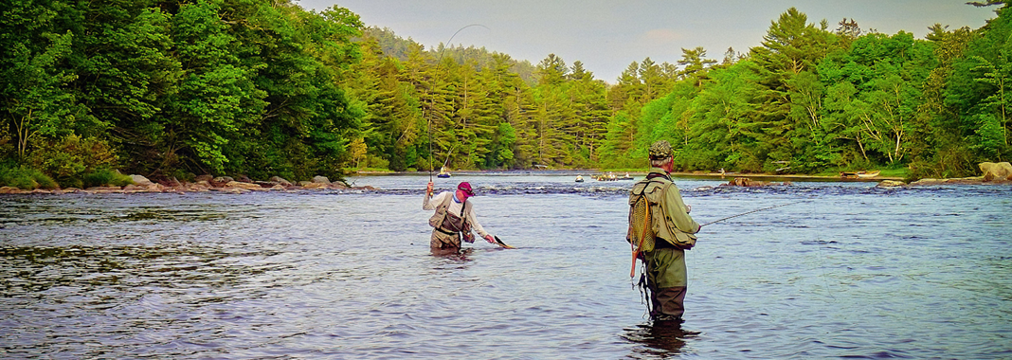
What’s Next
Aug 25, 2026
Sept 30, 2026
~Oct 26, 2026
Aug 27, 2027
Coalition filed FLA Comments
Current licenses expire; projects run on annual licenses
Brookfield's answers to FERC's information request due
Deadline for MDEP's Water Quality Certification decision
Late Sept 2026
Oct 12, 2026
Nov 13, 2026
Then
MDIFW files on the 2023, 2025 and 2026 fish kills
Brookfield's reply comments on the FLA comments due
Coalition files WQC Application Comments
FERC environmental review, then new licenses for decades
Photo: Tim Shaw
Notes:
What's next. TU filed its Motion to Intervene and Protest on August 19, so we are a formal party. The licenses expire September 30 and the projects will run on annual licenses. Brookfield's answers to FERC are due around October 26. TU will comment on the Water Quality Certification applications in early December, and MDEP must decide by August 27, 2027. Then FERC does its environmental review and issues licenses that will run for decades.

Slide 33
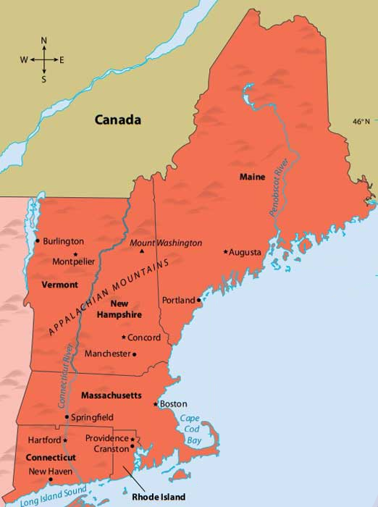
Not Just a Maine Fight
  Big operators watch outcomes
  Weak licenses get copied
  Strong records and strong conditions set
Out-of-State Voices Matter
  Comments, visibility, solidarity
  Massachusetts filed more supporting comments than any state outside Maine
  Supporting the alliance makes the “public interest” harder to ignore
  Protect your own fishing
Notes:
This matters beyond Maine. Weak licenses get copied. And out-of-state voices count — Massachusetts residents filed more supporting comments than any other state outside Maine.

Slide 34
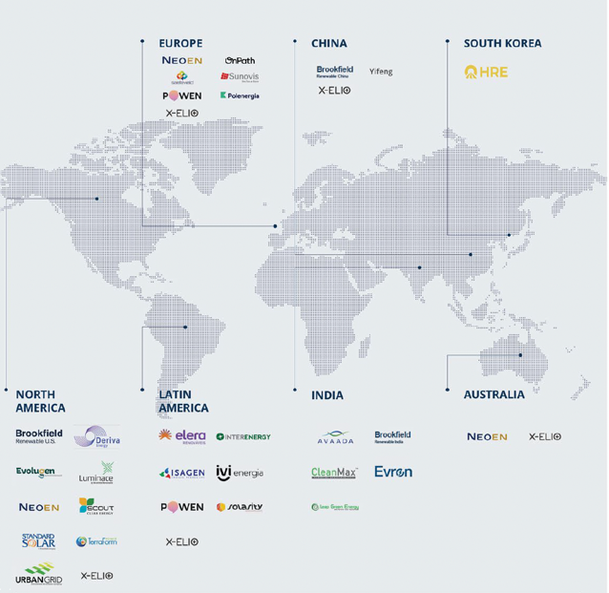
Why Legal Capacity Matters
Brookfield plans for litigation as a matter of course
  A room full of lawyers in Toronto
  Owner of Deerfield hydro projects
Appeal paths evaluated after license issuance
  Short response windows after license issuance
Funding must exist before deadlines hit
Grant funding for advocacy and litigation almost impossible to obtain
The Legal Defense Fund is essential to effective response
Brookfield
Notes:
Brookfield plans for litigation as a matter of course. Response windows after a license issues are short, and grant money for advocacy and litigation is almost impossible to get. That's why the Legal Defense Fund exists.

Slide 35
New Legal Developments
Lower Kennebec (Oct. 2025): Brookfield withdrew its Water Quality Certification applications for Lockwood, Hydro-Kennebec, Shawmut and Weston, and agreed to sell the four dams to The Nature Conservancy
  Cited an “increasingly complex, expensive, and uncertain regulatory landscape”
Ellsworth: MDEP has denied certification twice (2020 and June 2026)
  Brookfield took the first denial to Maine’s highest court, which dismissed the appeal in January 2025
  Appealed the second denial in Kennebec Superior Court on July 2, 2026
Lewiston Falls: MDEP certified the project July 8, 2026, with eel passage and other conditions
  Brookfield sued July 30 to strike five of the conditions
West Branch: We like where we stand. But if MDEP and FERC give us what we are asking for, we expect Brookfield to appeal and sue, possibly all the way to the Supreme Court
Notes:
Brookfield's pattern elsewhere in Maine. On the lower Kennebec it withdrew its certification applications and is selling the four dams to The Nature Conservancy, blaming the regulatory landscape. At Ellsworth, MDEP has denied certification twice; Brookfield fought the first denial all the way to the Law Court, which dismissed the appeal in January 2025, and it appealed the second denial on July 2. At Lewiston Falls, MDEP granted certification with eel passage and other conditions, and Brookfield sued on July 30 to strike five of them. We like where we stand on the West Branch. But if MDEP and FERC give us what we are asking for, we expect Brookfield to appeal and sue, possibly all the way to the Supreme Court. That is why the Legal Defense Fund matters.

Slide 36
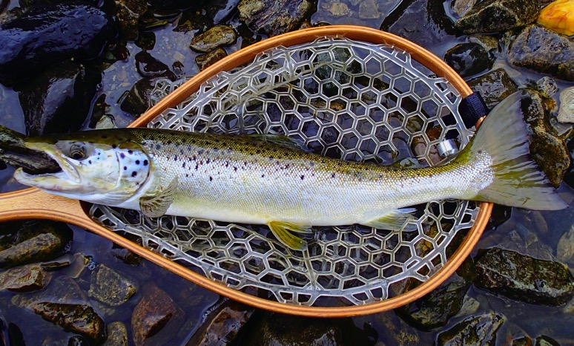
To Close
Legal Defense Fund supports Maine relicensings
Fund supports the right tool for the situation
Maine TU Council website supports direct donation
  https://app.autobooks.co/pay/trout-unlimited
A fishery at the crossroads
Photo: Tim Shaw
Notes:
The Legal Defense Fund supports several Maine relicensings. Not every case needs litigation — the fund supports the right tool for the situation.

Slide 37
Thank You & Contact
Steve Heinz
  heinz@maine.rr.com
  207 781-4762 (voice/fax only)
https://tumaine.org/ -> Dam Relicensing
Legal Defense Fund - https://app.autobooks.co/pay/trout-unlimited
West Branch Anglers’ Survey Report - https://tumaine.org/sites/default/files/Dam%20Relicensing/20260127-5253_West%20Branch%20Penobscot%20River%20-%20Angler%20Survey%20and%20Economic%20Assessment%202025.pdf
Coalition FLA Comments - https://tumaine.org/sites/default/files/Dam%20Relicensing/Coalition%20FLA%20Comments.pdf
Notes:
Thank you — and thanks to Fran Smith, Peter Schilling and Mike Bartlett for making this possible. Contact information and the donation link are on the slide.

Slide 38
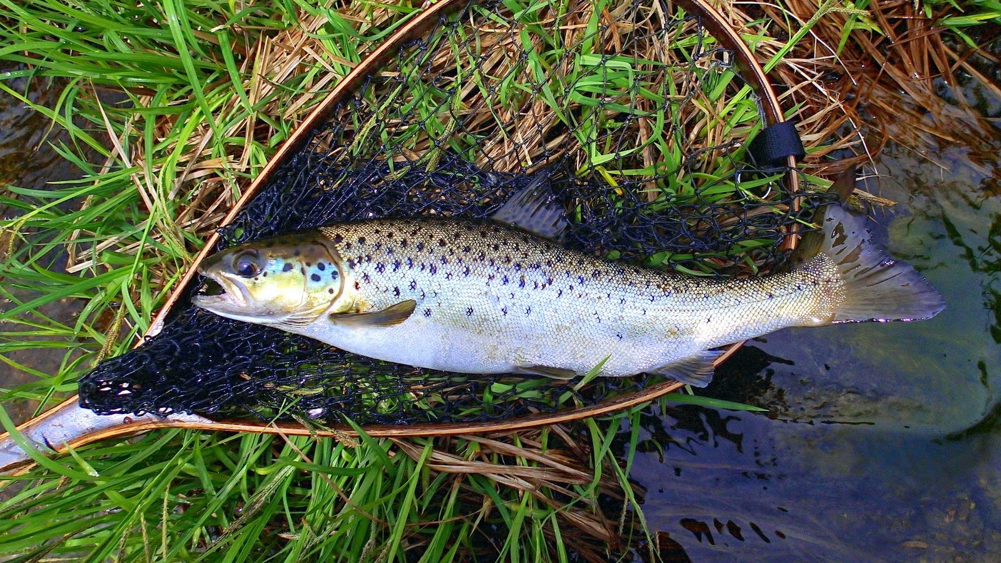
Questions?
Photo: Tim Shaw
Notes:
Questions.

